Slide 1
ENG 346 Data Structures and Algorithms for Artificial Intelligence Searching Techniques
Dr. Mehmet PEKMEZCİ
mpekmezci@gtu.edu.tr

Slide 2
Searching
The fundamental process of locating a specific element or item within a collection of data.
arrays, lists, trees, …
Objective: Determine whether the requested element exists within the data, and if so, identify its precise location or retrieve it.
Why is it important?
Efficiency: Efficient searching algorithms improve program performance.
Data Retrieval: Quickly find and retrieve specific data from large datasets.
Database Systems: Enables fast querying of databases.
Problem Solving: Used in a wide range of problem-solving tasks.

Slide 3
Applications of Searching
Information Retrieval: Search engines like Google, Bing, and Yahoo use sophisticated searching algorithms to retrieve relevant information from vast amounts of data on the web.
Database Systems: Searching is fundamental in database systems for retrieving specific data records based on user queries, improving efficiency in data retrieval.
E-commerce: Searching is crucial in e-commerce platforms for users to find products quickly based on their preferences, specifications, or keywords.
Networking: In networking, searching algorithms are used for routing packets efficiently through networks, finding optimal paths, and managing network resources.
Artificial Intelligence: Searching algorithms play a vital role in AI applications, such as problem-solving, game playing (e.g., chess), and decision-making processes
Pattern Recognition: Searching algorithms are used in pattern matching tasks, such as image recognition, speech recognition, and handwriting recognition.

Slide 4
Linear Search
The Algorithm examines each element one by one.
If it finds any element that is exactly the same as the key you're looking for, the search is successful, and it returns the index of key.
If it goes through all the elements and none of them matches the key, then that means "No match is Found".
LinearSearch(collection, key):
for each element in collection:
if element is equal to key:
return the index of the element
return "Not found"
Time Complexity:
Best Case: O(1)
Worst Case: O(N)
Average Case: O(N)

Slide 5
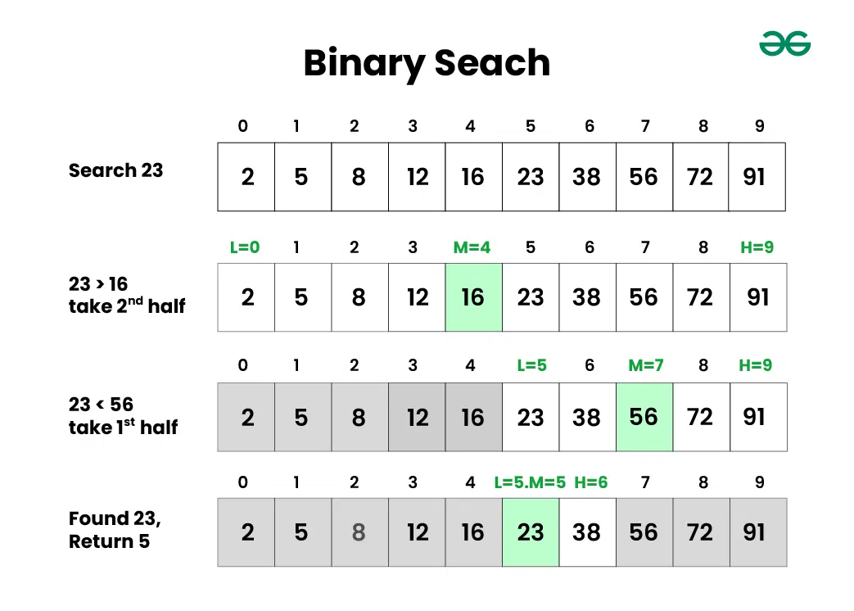
Binary Search
Search algorithm used in a sorted data
➔Repeatedly divide the search interval in half.

Slide 6
Binary Search – continued
Advantages of Binary Search
Binary search is faster than linear search, especially for large arrays.
More efficient than other searching algorithms with a similar time complexity, such as interpolation search or exponential search.
Binary search is well-suited for searching large datasets that are stored in external memory, such as on a hard drive or in the cloud.
Disadvantages of Binary Search
The array should be sorted.
Binary search requires that the data structure being searched be stored in contiguous memory locations.
Binary search requires that the elements of the array be comparable, meaning that they must be able to be ordered.

Slide 7
Binary Search – Generic Algorithim
binarySearch(collection, key):
left = 0
right = length(collection) - 1
while left <= right:
mid = (left + right) // 2
if collection[mid] == key:
return mid
elif collection[mid] < key:
left = mid + 1
else:
right = mid - 1
return "Not found"
Time Complexity:
Best Case: O(1)
Worst Case: O(log N)
Average Case: O(log N)

Slide 8
Binary Search – Iterative Version
# It returns location of x in given array arr
def binarySearch(arr, low, high, x):
while low <= high:
mid = low + (high - low) // 2
# Check if x is present at mid
if arr[mid] == x:
return mid
# If x is greater, ignore left half
elif arr[mid] < x: low = mid + 1
# If x is smaller, ignore right half
else: high = mid - 1
# Otherwise the element was not present
return -1
# Driver Code
if __name__ == '__main__':
arr = [2, 3, 4, 10, 40]
x = 10
# Function call
result = binarySearch(arr, 0, len(arr)-1, x)
if result != -1:
print("Element is present at index", result)
else:
print("Element is not present in array")

Slide 9
Binary Search – Recursive Version
# Returns index of x in arr if present, else -1
def binarySearch(arr, low, high, x):
# Check base case
if high >= low:
mid = low + (high - low) // 2
# If element is present at the middle itself
if arr[mid] == x: return mid
# If element is smaller than mid, then it
# can only be present in left subarray
elif arr[mid] > x:
return binarySearch(arr, low, mid-1, x)
# Else the element can only be present
# in right subarray
else:
return binarySearch(arr, mid+1, high, x)
# Element is not present in the array
else:
return -1
# Driver Code
if __name__ == '__main__':
arr = [2, 3, 4, 10, 40]
x = 10
# Function call
result = binarySearch(arr, 0, len(arr)-1, x)
if result != -1:
print("Element is present at index", result)
else:
print("Element is not present in array")

Slide 10
Hashing
Hash Function
Function that takes an input (or ‘message’) and returns a hash code, i.e. number or fixed-size string of bytes.
➔Efficiently map data of arbitrary size to fixed-size values, which are often used as indexes in hash tables.
Key Properties of Hash Functions
Deterministic: A hash function must consistently produce the same output for the same input.
Fixed Output Size: The output of a hash function should have a fixed size, regardless of the size of the input.
Efficiency: The hash function should be able to process input quickly.
Uniformity: The hash function should distribute the hash values uniformly across the output space to avoid clustering.
Pre-image Resistance: It should be computationally infeasible to reverse the hash function, i.e., to find the original input given a hash value.
Collision Resistance: It should be difficult to find two different inputs that produce the same hash value.
Avalanche Effect: A small change in the input should produce a significantly different hash value.

Slide 11
Hashing
Types of Hash Functions
Division Method: h(k)=k mod m
Multiplication Method: h(k)=⌊m(k*A mod 1)⌋
Mid-Square Method: Middle digits of k^2
Folding Method: Fold number on itself
Cryptographic Hash Functions: MD5, SHA-1, SHA-256
Universal Hashing: h(k)=((a*k+b) mod p) mod m
Perfect Hashing:

Slide 12
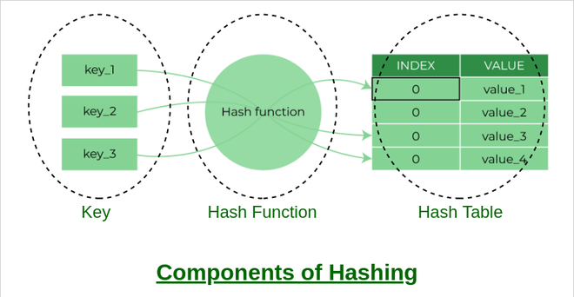
Hash Data Structure
Store and retrieve <key, value> pairs efficiently
Key: Any number or string value in <key, value> pair
Hash Function: Function that returns possible location for key
Hash code/index → Data location in a collection
Hash (table): Data structure that maps keys to values

Slide 13
Hash Data Structure
Advantages of Hashing in Data Structures
Key-value support: Hashing is ideal for implementing key-value data structures.
Fast data retrieval: Hashing allows for quick access to elements with constant-time complexity.
Efficiency: Insertion, deletion, and searching operations are highly efficient.
Memory usage reduction: Hashing requires less memory as it allocates a fixed space for storing elements.
Scalability: Hashing performs well with large data sets, maintaining constant access time.
Security and encryption: Hashing is essential for secure data storage and integrity verification.

Slide 14
Hash Table Example
Data: <Key, Value>
Hash Function:
Hash Table:

Slide 15
Collusion Resolution
Collusion occurs when two or more keys have the same hash value
Resolution:
Linear Probing: Check the next slot until you find an empty slot.
Quadratic Probing: Check the i^2th slot in the ith iteration.
Separate Chaing

Slide 16
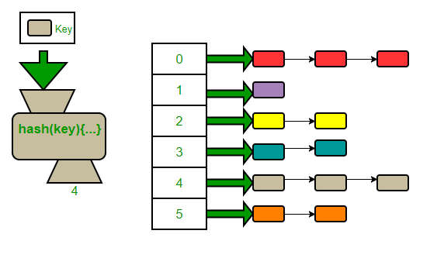
Separate Chaining
The array stores Head to linked lists.
The linked lists store the elements.

Slide 17
Separate Chaining
Advantages:
Simple to implement.
Hash table never fills up, we can always add more elements to the chain.
Less sensitive to the hash function or load factors.
It is mostly used when it is unknown how many and how frequently keys may be inserted or deleted.
Disadvantages:
The cache performance of chaining is not good as keys are stored using a linked list. Open addressing provides better cache performance as everything is stored in the same table.
Wastage of Space (Some Parts of the hash table are never used)
If the chain becomes long, then search time can become O(n) in the worst case
Uses extra space for links

